Slide 1
Meeting 2
Chapter 1- Introduction

Slide 2
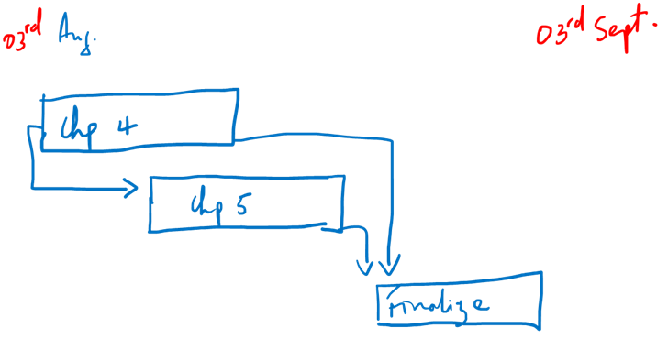

Slide 3
Purpose of Chapter 1
Establishing the context & Brief review of the relevant academic literature
Explaining the significance or value of the study
Identifying a problem, controversy or a knowledge gap
Stating the aim(s) of the research and the research questions
Synopsis of the research design
Defining certain key terms
Overview of the dissertation or report structure

Slide 11
